Slide 1
COMPUTER FUNDAMENTALS
.
A 1.1 .9 Cloud Computing

Slide 2
A 1.19
Inquiry Statement : Describe the different types of services in cloud computing.
Skills
Students will be able to analyze different computing needs and recommend appropriate cloud service models based on specific requirements.
Students will be able to evaluate the trade-offs between different cloud service models regarding cost, control, flexibility, and security.
Students will be able to research and compare different cloud providers and their offerings.
ATL (Approaches to Learning) Skills
Communication: Students will effectively communicate their understanding of cloud computing concepts and service models through discussions, presentations, and written explanations.
Collaboration: Students will work collaboratively in groups to analyse scenarios, research cloud services, and design cloud solutions.
Critical Thinking: Students will analyze the advantages and disadvantages of different cloud service models, evaluate their suitability for various applications, and make informed decisions about cloud adoption.
Information Literacy: Students will effectively use online resources and research to deepen their understanding of cloud computing technologies, providers, and trends.
Reflection: Students will consider the impact of cloud computing on businesses, society, and their own lives as technology users.
Transfer: Students will be able to apply their understanding of cloud computing concepts to new and emerging technologies and services.

Slide 3




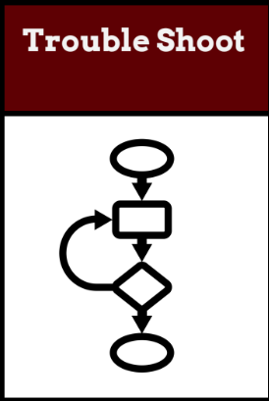
Do Now Activity (5 mins)
Identify the and explain the
Components of Computer
TOK
To what extent can data manipulation be considered an objective process when human judgment influences how databases are designed and interpreted?
Success Criteria:
Students will be able to define cloud computing and its key characteristics (on-demand self-service, broad network access, resource pooling, rapid elasticity, and measured service).
Students will be able to identify and differentiate between the three main cloud service models: SaaS, PaaS, and IaaS.
Students will be able to explain each service model's different levels of control, flexibility, and responsibility.
Students will be able to describe real-world scenarios and applications of each cloud service model.
Learning Intention:
Describe the different types of services in cloud computing.

Slide 4
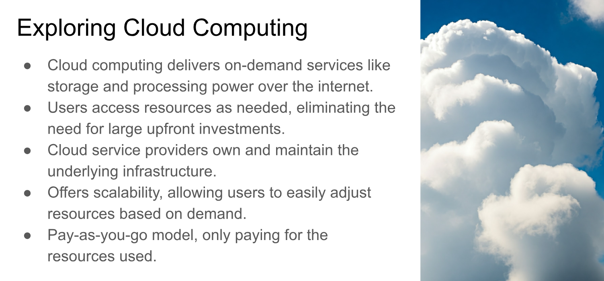

Slide 5
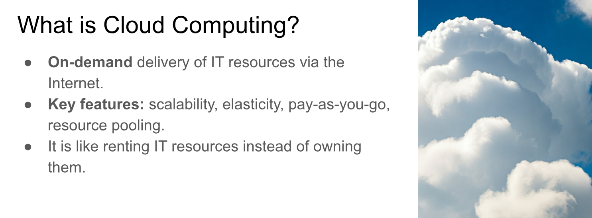

Slide 6
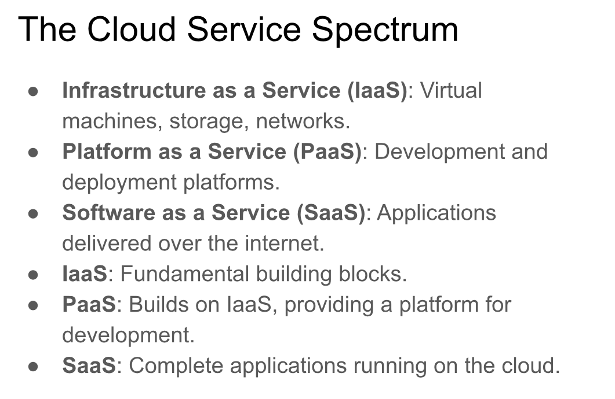

Slide 7
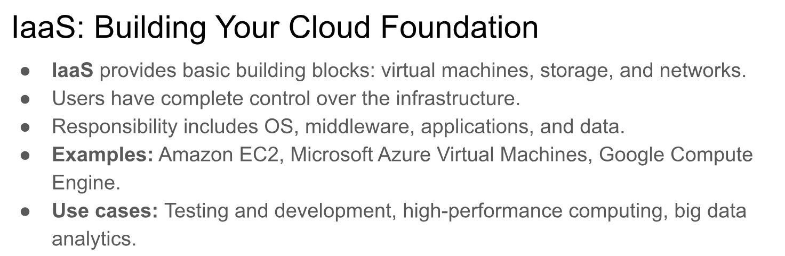

Slide 8
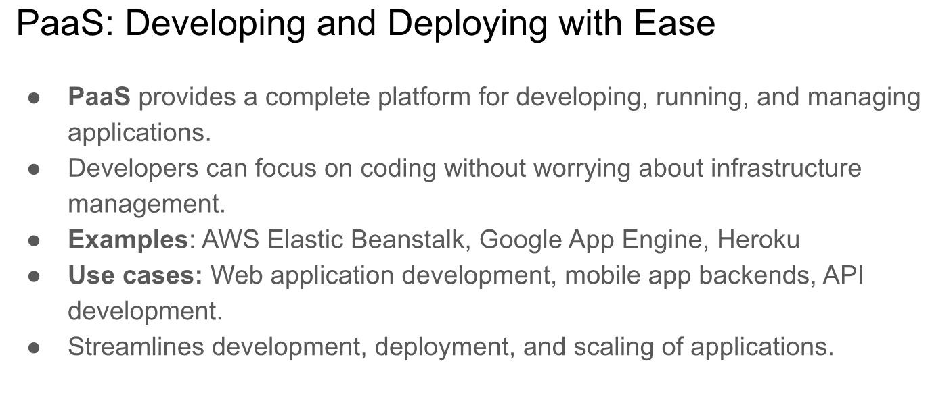

Slide 9
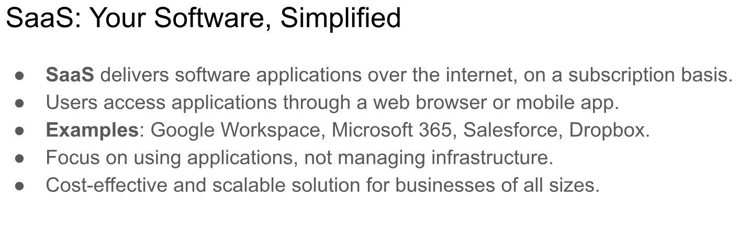

Slide 10
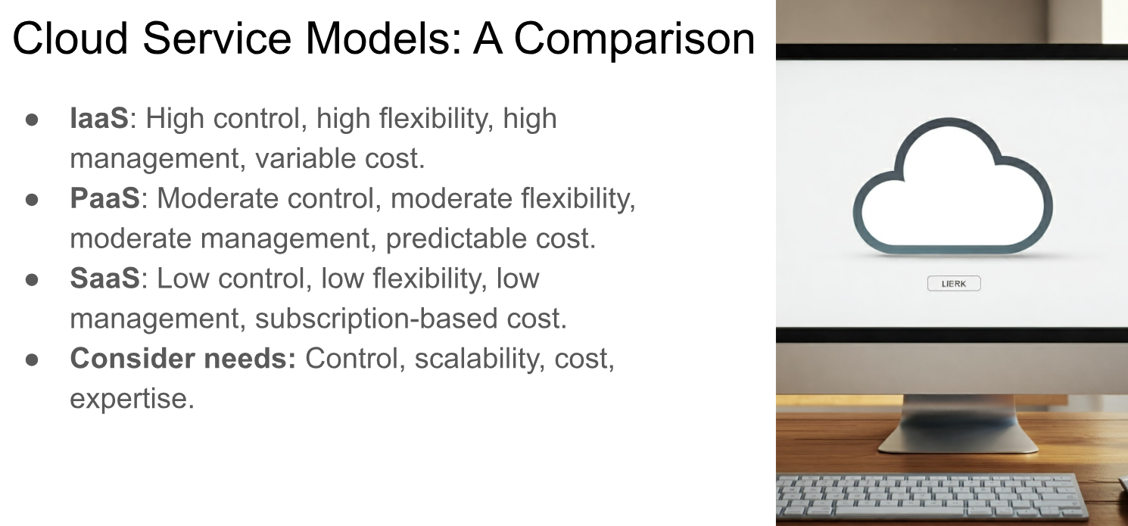

Slide 11
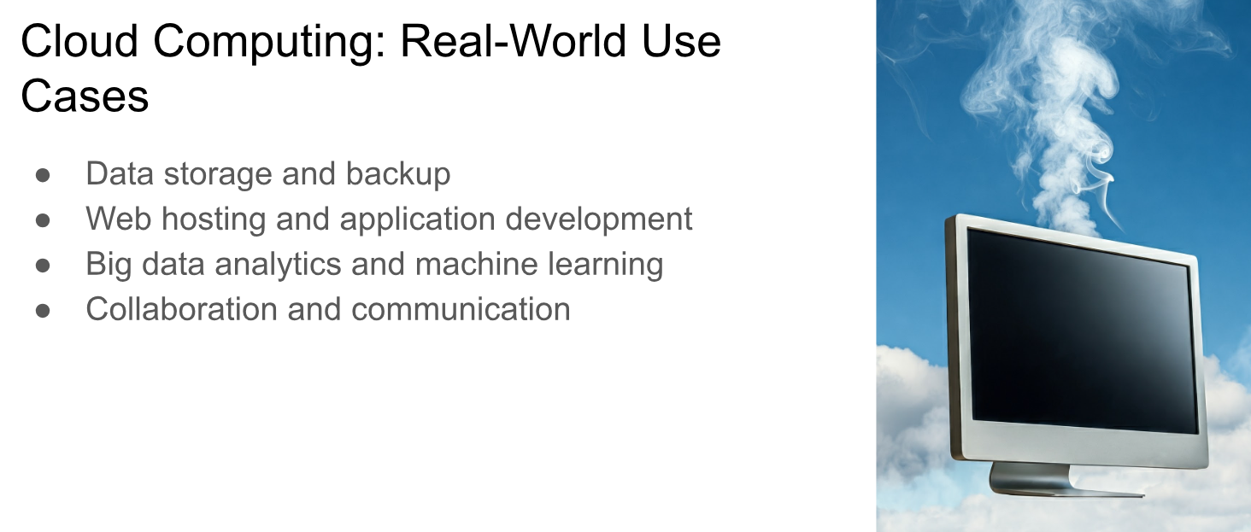

Slide 12
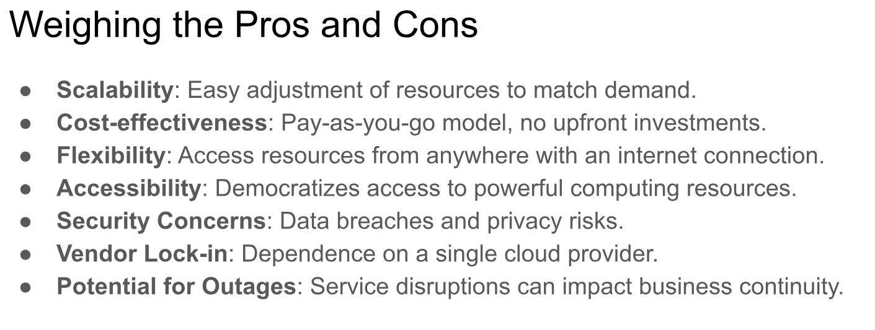

Slide 13
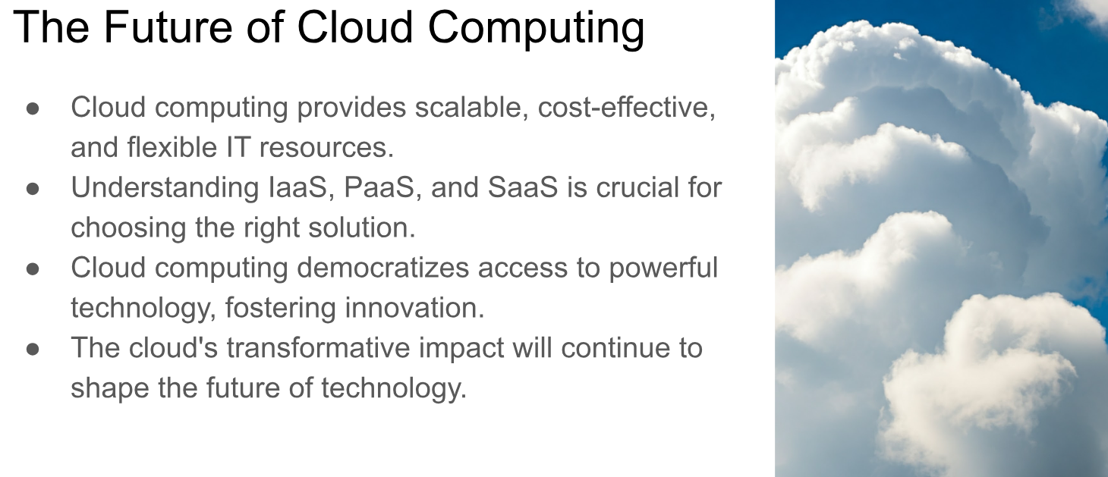

Slide 14
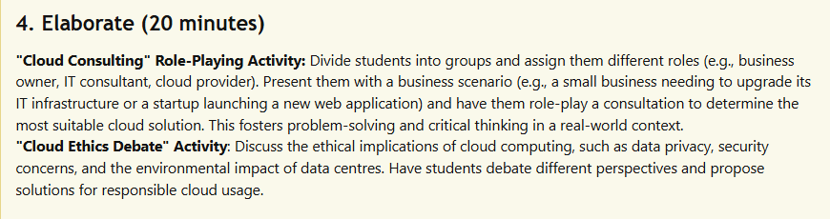
GROUP TASK

Slide 15
Evaluate (5 minutes)
Students write a short reflection on the following prompt: "How do you think cloud computing will impact the future of technology and society?" This encourages students to consider the broader implications of cloud computing and its innovation potential.

